Slide 1
CSE 422 ARTIFICIAL INTELLIGENCE
HEURISTICS

Slide 2

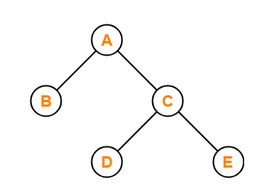
Uninformed Search Blind Search Strategy
BFS, DFS, IDS etc.
“Blindly” looks for the goal state
No sense of how much closer or distant we are getting from the goal
Initial state
Goal state

Slide 3
The Heuristic Function Heuristics
An estimate of the cheapest path cost from any node to a goal node.
Represented by h(n)
Reduces time complexity
By visiting only most promising nodes
Thus reducing the search space
To solve an NP problem in Polynomial time. For e.g.,
3²² possible states for an 8 puzzle problem
Search space and time increases exponentially
Can be completed in polynomial time using heuristics

Slide 4
The Heuristic Function Heuristics
Greedy Best First Search, f(n) = h(n)
A* Search, f(n) = h(n) + g(n);
Here h(n) is the estimated path cost from current node n to the goal node and g(n) is the actual path cost from initial state to current node n
Some other examples may include :
Euclidean Distance
Manhattan Distance
Misplaced Tiles

Slide 5
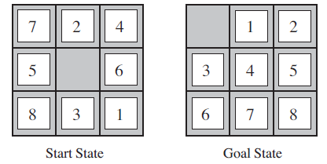
Misplaced Tiles 8 puzzle problem
h(n) = number of tiles that are out of position in state/node n
For the start state h(n) = 8 as all tiles are out of position in comparison to the goal
Following a best first search procedure, expanding the start state, we will get 4 newer states.
Calculate value of h(n) for each state and expand the state with the least value of h(n) i.e. the best state
Continue same process until we reach goal state
8 puzzle problem

Slide 6
Manhattan Distance 8 puzzle problem
h(n) = sum of the distances of the tiles from their current position to the goal positions for a state n
For the start state h(n) = 3 + 1 + 2 + 2+ 2 + 3 + 3 + 2 = 18 (distances for tiles 1 to 8).
Remember that tiles can only move in right angles i.e. either vertically or horizontally
Following a best first search procedure, expanding the start state, we will get 4 newer states.
Calculate value of h(n) for each state and expand the state with the least value of h(n) i.e. the best state
Continue same process until we reach goal state
8 puzzle problem

Slide 7

Choosing a Good Heuristic Admissibility
If a heuristic, h(n) is admissible, then that means it will always underestimate the actual cost to the goal. An admissible heuristic will always give optimal results
Lets say if,
h(n) is the estimated cost from node n to the goal state
h*(n) is the actual cost from node n to the goal state
Then h(n) will be admissible if h(n) ≤ h*(n) is true for all states/nodes n
For e.g. Euclidean / Straight line distance is an admissible heuristic. Because the shortest path between any two points is the straight line distance between the points. Therefore it is the minimum possible distance between the two points and so it can never be greater than the actual distance.
h(n) = 10
Actual cost = 15

Slide 8
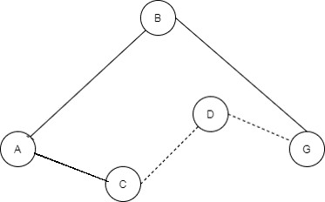
Choosing a Good Heuristic Consistency
h(n) ≤ h*(n, n*) + h(n*)
h(n) is the estimated heuristic from node n to the goal
n* represents any neighbor of node n
h*(n, n*) is the actual path cost from node n to any of its neighbors n*
h(n*) is the estimated heuristic from node n* to the goal
And this should be true for all nodes n and for all of their neighbors n*
h(B)
h*(A,B)
h(A)
Start state
h(C)
Goal state
h(A) ≤ h*(A,B) + h(B)
h(A) ≤ h*(A,C) + h(C)

Slide 9
Choosing a Good Heuristic Dominance
Total Misplaced tiles, h₁ = 8
Total Manhattan distance, h₂ = 18
Now if both h₁(n) and h₂(n) are admissible and h₂(n) ≥ h₁(n) for all nodes n, then we say h₂(n) dominates h₁(n).
h₂(n) will be better for search and will search less nodes than h₁(n)
If there are several admissible heuristic, the one with highest value should be chosen
The estimated cost, h (n) should be made as large as possible without exceeding the actual cost, h*(n)
8 puzzle problem

Slide 10
Choosing a Good Heuristic Effective Branching Factor
N+1 = 1 + b* + (b*)² + (b*)³ + …… + (b*)^{d}
N is the total number of nodes generated by A* search
d is the solution depth
b* is the branching factor that a uniform tree of depth d would have to have in order to contain N + 1 nodes
For e.g. if we reach a goal state at depth 5 using 52 nodes after using A*, then the effective branching factor is 1.92
The branching factor directly corresponds with the heuristic being used
Choose the heuristic which results in lesser branching factor

Slide 11
Generate an Admissible Heuristic Constraint Relaxation
A Relaxed problem is created by removing preconditions or constraints from the original problem. This creates an approximation of the original problem by dropping the constraints. Newer edges are created in the relaxed problem making it simpler than the original problem. A solution to the relaxed problem will be a lower bound of the solution for the original problem
Therefore, an optimal solution to the relaxed problem will be an admissible heuristic for the original problem

Slide 12
Generate an Admissible Heuristic Constraint Relaxation
Identify the preconditions or constraints
Create relaxed problems by dropping the preconditions or constraints
Solve the relaxed problems without searching
An optimal solution of a relaxed problem will be an admissible heuristic for the original problem.
Let us understand this with the help of the 8 puzzle problem

Slide 13
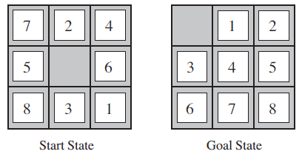
Generate an Admissible Heuristic Constraint Relaxation
Preconditions/constraints:
A tile will be on a specific cell
A tile can move to a new cell if it is horizontally or vertically adjacent to it
A tile can only move to a new cell if the new cell is clear/empty
8 puzzle problem

Slide 14
Generate an Admissible Heuristic Constraint Relaxation
Keep precondition/constraint (I), (II) and drop (III) :
A newer relaxed version of the problem is thus created
A tile will be placed initially in a specific cell and any tile can move either vertically or horizontally without taking into account whether destination cell is clear/empty
An optimum solution can be found by calculating the shortest path between the initial position and the goal positions for each tile
This solution is exactly the same as Manhattan Distance heuristic.
Therefore, the Manhattan Distance can be a admissible heuristic for the original 8 puzzle problem

Slide 15
Generate an Admissible Heuristic Constraint Relaxation
Drop precondition/constraint (II) and (III) :
Again another newer relaxed version of the problem is thus created
A tile will be placed initially in a specific cell and now can move into any other position in any way without worrying about adjacency or a clear/empty destination
An optimum solution can be found by simply counting the number of tiles who are not in their goal positions
Accordingly Misplaced Tiles can be used to calculated the length of the optimum solution here
Therefore, the solution using Misplaced Tiles will be a admissible heuristic for the original problem

